Slide 1

Database Processing: Fundamentals, Design, and Implementation
15th Edition
Week #9 – Part 1
The Relational Model and Normalization

Slide 2
The Relational Model
Introduced in 1970
Created by E.F. Codd
IBM engineer
The model used mathematics known as “relational algebra”
Now the standard model for commercial DBMS products

Slide 3
Entity
An entity is some identifiable thing that users want to track:
Customers
Computers
Sales

Slide 4
Relation
Relational DBMS products store data about entities in relations, which are a special type of table.
A relation is a two-dimensional table that has the following characteristics:
Characteristics of Relations
Rows contain data about an entity.
Columns contain data about attributes of the entities.
All entries in a column are of the same kind.
Each column has a unique name.
Cells of the table hold a single value.
The order of the columns is unimportant.
The order of the rows is unimportant.
No two rows may be identical.

Slide 5
The Domain Integrity Constraint
The requirement that all of the values in a column are of the same kind is know as the domain integrity constraint.
The term domain means a grouping of data that meets a specific type definition.
FirstName could have a domain of names such as Albert, Bruce, Cathy, David, Edith, and so forth.
All values of FirstName must come from the names in that domain.
Columns in different relations may have the same name.

Slide 6
A Sample EMPLOYEE Relation
EmployeeNumber | FirstName | LastName | Department | EmailAddress | Phone
100 | Jerry | Johnson | Accounting | JJ@somewhere.com | 518-834-1101
200 | Mary | Abernathy | Finance | MA@somewhere.com | 518-834-2101
300 | Liz | Smathers | Finance | LS@somewhere.com | 518-834-2102
400 | Tom | Caruthers | Accounting | TC@somewhere.com | 518-834-1102
500 | Tom | Jackson | Production | TJ@somewhere.com | 518-834-4101
600 | Eleanore | Caldera | Legal | EC@somewhere.com | 518-834-3101
700 | Richard | Bandalone | Legal | RB@somewhere.com | 518-834-3102

Slide 7
Tables That are Not Relations: Multiple Entries per Cell
EmployeeNumber | FirstName | LastName | Department | EmailAddress | Phone
100 | Jerry | Johnson | Accounting | JJ@somewhere.com | 518-834-1101
200 | Mary | Abernathy | Finance | MA@somewhere.com | 518-834-2101
300 | Liz | Smathers | Finance | LS@somewhere.com | 518-834-2102
400 | Tom | Caruthers | Accounting | TC@somewhere.com Fax: Home: | 518-834-2102 518-834-9911 518-723-8795
500 | Tom | Jackson | Production | TJ@somewhere.com | 518-834-4101
600 | Eleanore | Caldera | Legal | EC@somewhere.com Fax: Home: | 518-834-3101 518-834-9912 518-723-7654
700 | Richard | Bandalone | Legal | RB@somewhere.com | 518-834-3102

Slide 8
Tables That Are Not Relations Table with Required Row Order
EmployeeNumber | FirstName | LastName | Department | EmailAddress | Phone
100 | Jerry | Johnson | Accounting | JJ@somewhere.com | 518-834-1101
200 | Mary | Abernathy | Finance | MA@somewhere.com | 518-834-2101
300 | Liz | Smathers | Finance | LS@somewhere.com | 518-834-2102
400 | Tom | Caruthers | Accounting | TC@somewhere.com | 518-834-2102
 |  |  |  | Fax: | 518-834-9911
 |  |  |  | Home: | 518-723-8795
500 | Tom | Jackson | Production | TJ@somewhere.com | 518-834-4101
600 | Eleanore | Caldera | Legal | EC@somewhere.com | 518-834-3101
 |  |  |  | Fax: | 518-834-9912
 |  |  |  | Home: | 518-723-7654
700 | Richard | Bandalone | Legal | RB@somewhere.com | 518-834-3102

Slide 9
A Relation with Values of Varying Length
EmployeeNumber | FirstName | LastName | Department | EmailAddress | Phone | Comment
100 | Jerry | Johnson | Accounting | JJ@somewhere.com | 518-834-1101 | Joined the Accounting Department in March after completing his MBA. Will take the CPA exam this fall.
200 | Mary | Abernathy | Finance | MA@somewhere.com | 518-834-2101
300 | Liz | Smathers | Finance | LS@somewhere.com | 518-834-2102
400 | Tom | Caruthers | Accounting | TC@somewhere.com | 518-834-1102
500 | Tom | Jackson | Production | TJ@somewhere.com | 518-834-4101
600 | Eleanore | Caldera | Legal | EC@somewhere.com | 518-834-3101
700 | Richard | Bandalone | Legal | RB@somewhere.com | 518-834-3102 | Is a full-time consultant to Legal on a retainer basis.

Slide 10
Functional Dependencies
A functional dependency occurs when the value of one (set of) attribute(s) determines the value of a second (set of) attribute(s):
CookieCost = NumberOfBoxes x $5
NumberOfBoxes → CookieCost
The attribute on the left side of the functional dependency is called the determinant.
Functional dependencies may be based on equations:
ExtendedPrice = Quantity X UnitPrice
(Quantity, UnitPrice) → ExtendedPrice
Functional dependencies are not equations!

Slide 11
Composite Determinants
Composite determinant = a determinant of a functional dependency that consists of more than one attribute
(StudentNumber, ClassNumber) → (Grade)

Slide 12
Functional Dependency Rules
If A → (B, C), then A → B and A→ C.
This is the decomposition rule.
If A → B and A→ C, then A → (B, C).
This is the union rule.
However, if (A,B) → C, then neither A nor B determines C by itself.

Slide 13
What Makes Determinant Values Unique?
A determinant is unique in a relation if and only if it determines every other column in the relation.
You cannot find the determinants of all functional dependencies simply by looking for unique values in one column:
Data set limitations
Must be logically a determinant

Slide 14
Keys
A key is a combination of one or more columns that is used to identify particular rows in a relation.
A composite key is a key that consists of two or more columns.

Slide 15
Candidate and Primary Keys
A candidate key is a key that determines all of the other columns in a relation.
A primary key is a candidate key selected as the primary means of identifying rows in a relation.
There is only one primary key per relation.
The primary key may be a single key or a composite key.

Slide 16
The Entity Integrity Constraint
The requirement that, in order to function properly, the primary key must have unique data values inserted into every row of the table. This is known as the entity integrity constraint.
The phrase unique data values implies that this column is NOT NULL, and does not allow a NULL value in any row.

Slide 17
Surrogate Keys (1 of 2)
A surrogate key is an artificial column added to a relation to serve as a primary key.
DBMS supplied
Short, numeric, and never changes—an ideal primary key
Has artificial values that are meaningless to users
Normally hidden in forms and reports

Slide 18
Surrogate Keys (2 of 2)
NOTE: The primary key of the relation is underlined below:
RENTAL_PROPERTY without surrogate key:
RENTAL_PROPERTY (Street, City, State/Province, Zip/PostalCode, Country, Rental_Rate)
RENTAL_PROPERTY with surrogate key:
RENTAL_PROPERTY (PropertyID, Street, City,
State/Province, Zip/PostalCode, Country, Rental_Rate)

Slide 19
Foreign Keys (1 of 2)
A foreign key is a column or composite of columns that is the primary key of a table other than the one in which it appears. The term arises because it is a key of a table foreign to the one in which it appears as the primary key.

Slide 20
Foreign Keys (2 of 2)
NOTE: The primary keys of the relations are underlined and any foreign keys are in italics in the relations below:
DEPARTMENT (DepartmentName, BudgetCode, ManagerName)
EMPLOYEE (EmployeeNumber, EmployeeLastName,
EmployeeFirstName, DepartmentName)

Slide 21
Foreign Key with a Referential Integrity Constraint
A referential integrity constraint is a statement that limits the values of the foreign key to those already existing as primary key values in the corresponding relation:
SKU_DATA (SKU, SKU_Description, Department, Buyer)
ORDER_ITEM (OrderNumber, SKU, Quantity, Price, ExtendedPrice)
Where ORDER_ITEM.SKU must exist in SKU_DATA.SKU

Slide 22
Database Integrity
We have defined three constraints so far in our discussion:
The domain integrity constraint
The entity integrity constraint
The referential integrity constraint
The purpose of these three constraints, taken as a whole, is to create database integrity, which means that the data in our database will be useful, meaningful data.

Slide 23
Types of Modification Anomalies (Compromising Integrity Constraints)
Deletion anomaly
Removal of existing data causing mis-matching of primary and foreign key records
Insertion anomaly
Insertion of new data causing mis-matching of primary and foreign key records
Update anomaly
Updating of existing data causing mis-matching of primary and foreign key records

Slide 24
Normalization Theory
Relations are categorized as a normal form based on which modification anomalies or other problems they are subject to:
Sources of Anomaly | Normal Forms | Design Principles
Functional Dependencies | 1NF, 2NF 3NF, BCNF | BCNF: Design tables so that every determinant is a candidate key
Multivalued dependencies | 4NF | 4NF: Move each multivalued dependency to a table of its own
Data constraints and oddities | 5NF, DK/NF | DK/NF: Make every constraint a logical consequence of candidate keys and domains

Slide 25
Eliminating Anomalies from Functional Dependencies with BCNF
Note: In step 3, if there is more than one such functional dependency, start with the one with the most columns.
Process for Putting a Relation into BCNF
1. Identify every functional dependency.
2. Identify every candidate key.
3. If there is a functional dependency that has a determinate that is not a candidate key:
A. Move the column of that functional dependency into a new relation. B. Make the determinant of that functional dependency the primary key of the new relation. C. Leave a copy of the determinant as a foreign key in the original relation. D. Create a referential integrity constraint between the original relation and the new relation.
4. Repeat step 3 until every determinant of every relation is a candidate key.

Slide 26
Multivalued Dependencies
A multivalued dependency occurs when a determinant is matched with a particular set of values:
Employee →→ Degree
Employee →→ Sibling
PartKit →→ Part
The determinant of a multivalued dependency can never be a primary key.

Slide 27
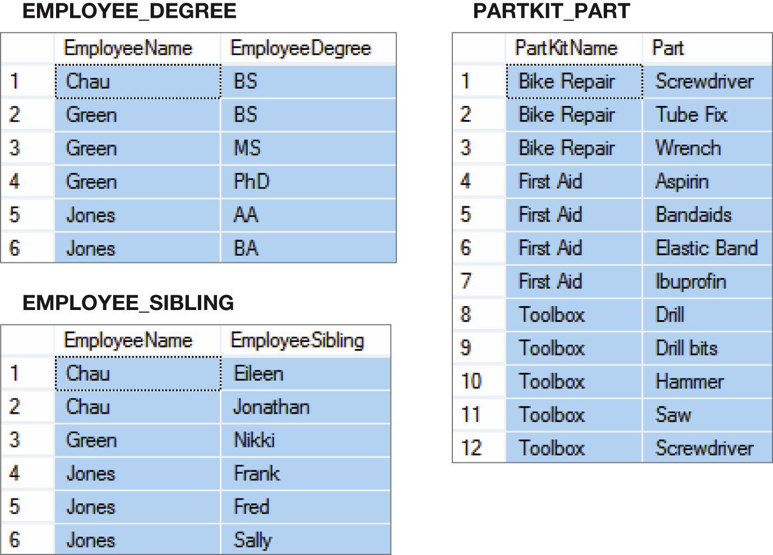
Examples of Multivalued Dependencies

Slide 28
Fourth Normal Form (4NF) Eliminating Multivalued Anomalies
Multivalued dependencies are not a problem if they are in a separate relation, therefore:
Always put multivalued dependencies into their own relation
This is know as Fourth Normal Form (4NF)

Slide 29
Database Processing Fundamentals, Design, and Implementation (15th Edition)
End of Presentation:
Week #9
Part 1

